Slide 1
COMPUTER ORGANIZATION AND ARCHITECTURE
Dr. Rijwan Khan

Slide 2
Function
All computer functions are:
Data processing
Data storage
Data movement
Control

Slide 3
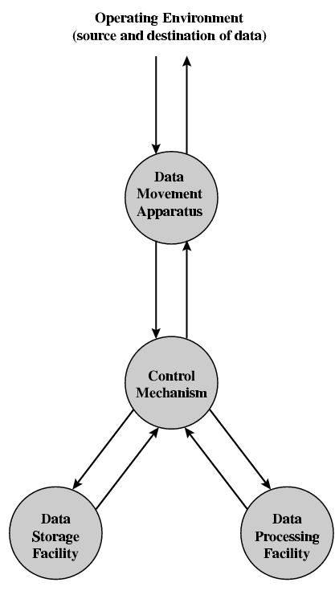
Functional View

Slide 4
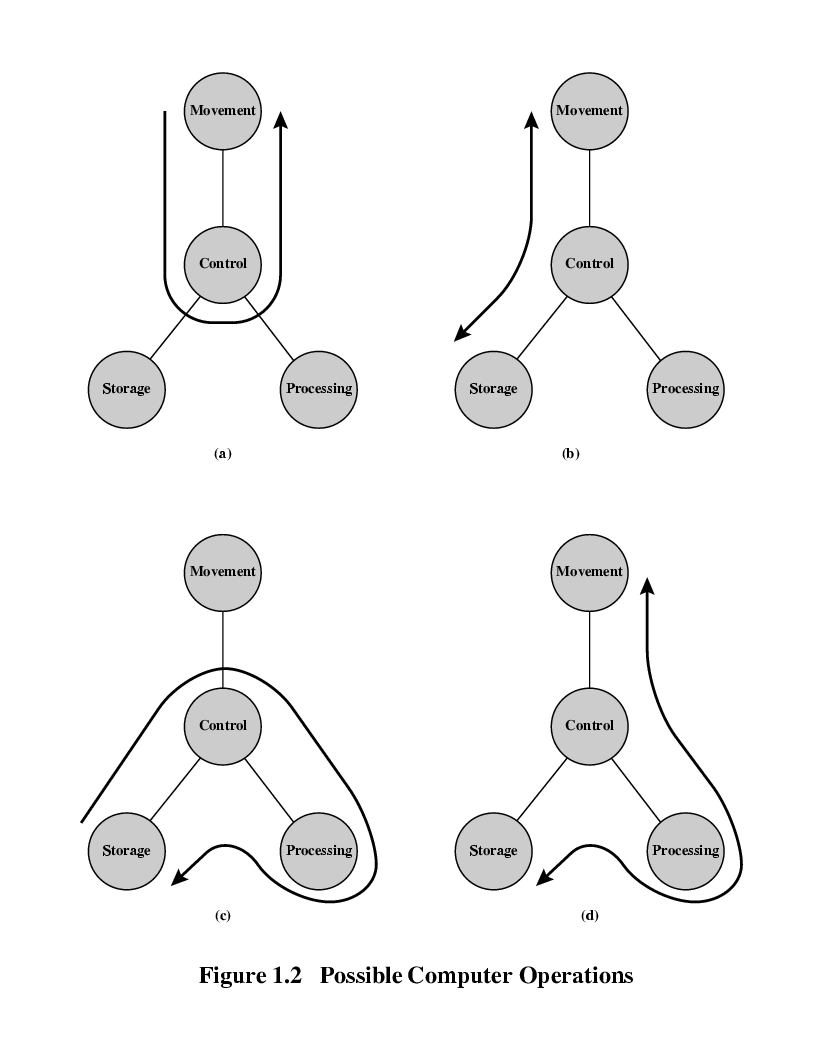
Operations (a) Data movement

Slide 5
Operations (b) Storage

Slide 6
Operation (c) Processing from/to storage

Slide 7
Operation (d) Processing from storage to I/O

Slide 8
Structure - Top Level
Peripherals
Computer
Central
Processing
Unit
Main
Memory
Computer
Systems
Interconnection
Input
Output
Communication
lines

Slide 9
Structure - The CPU
CPU
Computer
Arithmetic
and
Login Unit
I/O
Registers
System
Bus
CPU
Internal CPU
Interconnection
Memory
Control
Unit

Slide 10
Structure - The Control Unit
Control Unit
CPU
ALU
Sequencing
Logic
Internal
Bus
Control
Unit
Control Unit
Registers and
Decoders
Registers
Control
Memory

Slide 11
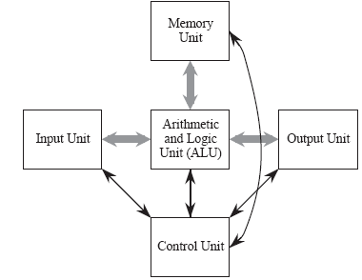
The Von Neumann Model
The Input Unit provides instructions and data to the system, which are subsequently stored in the Memory Unit . The instructions and data are processed by the Arithmetic and Logic Unit (ALU) under the direction of the Control Unit . The results are sent to the Output Unit . The ALU and control unit are frequently referred to collectively as the central processing unit (CPU)
The stored program is the most important aspect of the Von Neumann model. A program is stored in the computer’s memory along with the data to be processed.

Slide 12
The System Bus Model
This model partitions a computer system into three subunits: CPU, Memory, and Input/Output (I/O). This refinement of the von Neumann model combines the ALU and the control unit into one functional unit, the CPU. The input and output units are also combined into a single I/O unit.
Most important to the system bus model, the communications among the components are by means of a shared pathway called the system bus , which is made up of the data bus (which carries the information being transmitted), the address bus (which identifies where the information is being sent), and the control bus (which describes aspects of how the information is being sent, and in what manner).

Slide 13


